Slide 1
Algorithmic Trading for NVIDIA
By: Jeff, Exzavier, Nipun

Slide 2
Project Description
We will start with training a logistic regression model to NVDA stock data pulled from YFinance. We will be calculating the daily returns using the closing prices, defining short and long windows (50 and 100 respectively) to calculate the SMA. Once this is done we will then create buy and sell signals as well as training the model to identify those buy and sell signals based on our set parameters. After we train the data we will scale it and create a classification report to determine accuracy of the model we are using. All that which we have done up to this point will lead us to evaluate the model's ability to predict trading signals for the test data. Once the accuracy is shown to us in the classification report for this, we will calculate and plot the cumulative returns for the actual and trading algorithm returns. This is where the logistic regression model will come in, were will will predict the trade signals for the trained data and generate another classification report to determine its accuracy. Now that this is all done, we will compare the logistic regression to the SVM to determine if there were any changes in the accuracy of predicting. The new technology we used in this project is the Ichimoku Cloud and RSI indicators to help with predicting buy and sell signals. We pull the data as before and plot the close price in a chart to visualize it. RSI will be calculated using the pulled data and the Ichimoku cloud will be created by adding in the 5 lines of Tenkan, Kijun, Senkou span A, Senkou span B and Chikou Span B. Now we must generate trading signals and visualize the buy and sell points on a graph. After the calculation of the daily returns and strategy returns, we will plot the cumulative returns and plot the Ichimoku Cloud part of the code to visualize the buy and sell points.
Notes:
N

Slide 3
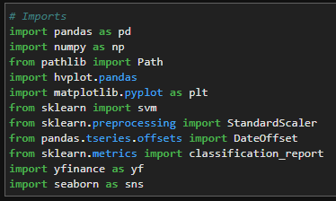
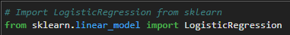
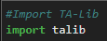
Importing Data
To install yfinance you must 'pip install yfinance' For the Ichimoku Cloud and RSI you must import the TA library by 'import talib' but first you need to make sure it is installed. To install it you must use '$ conda install -c conda-forge ta-lib' in the gitbash terminal.
The reason we used finance was to import the historical stock data for NVDA without needing to download a CSV. We also used it since it was more convenient when calculating the RSI which will be covered later.
All the other imports we have learned in class such as pandas, numpy, hvplot, sklearn, seaborn.
Notes:
E

Slide 4
Data Preparation
Import the NVDA dataset into a Pandas Dataframe from 8/31/20 to 8/31/23
Calculate daily returns using closing prices
-
Drop null values
-
Notes:
J

Slide 5
Data Preparation
Define short and long windows and assign them to appropriate columns
-
-
-
Drop nulls
Assign copy of sma-fst and sma_slow to X
-
Notes:
N

Slide 6
Data Preparation
Create a signal column
-
Create buy signal
-
Create Sell signal
-
Copy new signal column to a new series ‘y’
-
Notes:
E

Slide 7
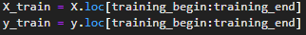
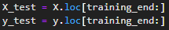
Data Training
Set start and end dates for data training
-
-
Generate X and y train dataframes
-
Generate X and y test dataframes
–
Notes:
J

Slide 8
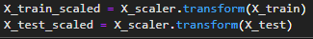
Data Scaling
Create standard scaler
-
Apply it to fit X_train data
-
Transform X_train and test dataframes
-
Notes:
N

Slide 9
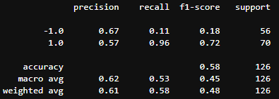
Data Analysis
Create a classifier model (SVM model)
-
Fit the model to the data
-
Predict trading signals
-
Evaluate the model
-
-
Notes:
E

Slide 10
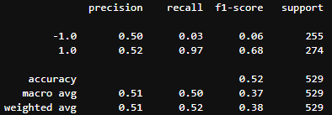
Data Analysis
Predict trade signals for testing data
-
Evaluate the model’s ability to predict the signal
-
-
Notes:
J

Slide 11
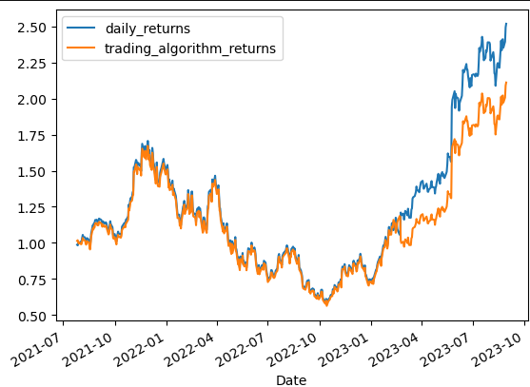
Data Analysis
Create a new empty predictions Dataframe
-
-
-
Calculate and plot cumulative returns
-
Notes:
N

Slide 12
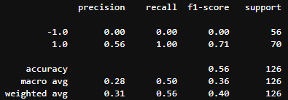
Data Analysis
Now we must create a logistic regression model
-
Fit the logistic regression model
-
Predict trading signals for the trained data
-
Generate a classification report
-
Notes:
E

Slide 13
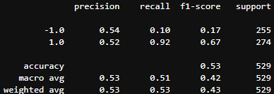
Data Analysis
Predict trading signals for the testing data
-
Generate a classification report
-
-
Notes:
J

Slide 14

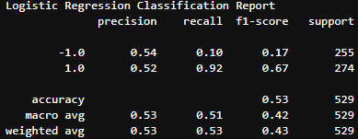
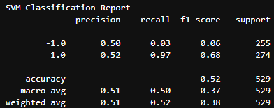
Comparing Logistic Regression and SVM Classification Reports
Logistic Regression
In comparing the F1 scores, the LR model did better at predicting the buy signals than the sell signals (0.17 /0.67). Neither were exceptionally accurate predictors. With the SVM model we noticed the F1 score for sell signals decreased to 0.06. We noticed the buy signal slightly increased to 0.68.
SVM
These figures support our hypothesis that utilizing long and short windows are not the best at identifying buy and sell points because both focus on price momentum.
A better combination of trade indicators would be to utilize RSI and Ichimoku cloud indicators.
Notes:
N

Slide 15
What is RSI and Ichimoku Cloud?
RSI is the relative strength index which is a momentum oscillator which is used in technical analysis. This particular indicator will measure the speed and magnitude of price changes and evaluate if they are over or undervalued.
Typical an RSI value over 70 is considered overbought while an RSI value under 30 is oversold.
Ichimoku Cloud is another indicator that calculates 5 lines of short to medium duration on high/low/close prices. It will plot an area between these lines which is called the Ichimoku Cloud.
These lines will help us in determining momentum, direction and support-resistance levels for the data. Ichimoku Cloud will also create buy and sell signals using this data.
It is vital to combine technical indicators to create good trading signals. The combination of RSI and Ichimoku Cloud is a great combination since the RSI identifies momentum while the Ichimoku Cloud helps identifying the direction of the trend.
Notes:
E

Slide 16
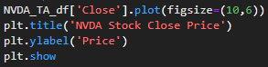
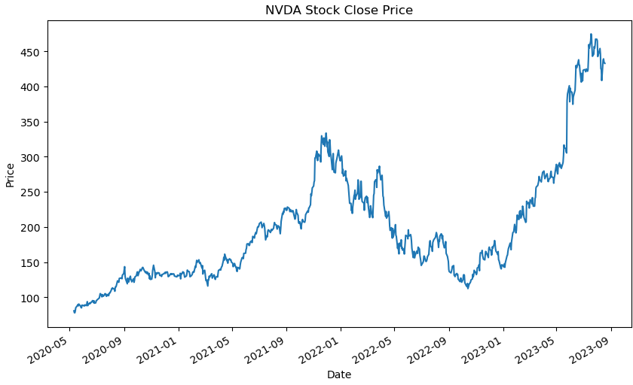
Calculate RSI
Retrieve stock price data
-
Calculate RSI
-
Plot price data to visualize close price
-
-
-
Notes:
N

Slide 17
Calculate Ichimoku Cloud
Tenkan Sen or Conversion Line: (9-period-high + 9-period-low)/2
Kijun Sen or Base Line: (26-period-high + 26-period-low)/2
Senkou Sen A or Leading Span A: (Base line + Conversion Line)/2
Senkou Sen B or Leading Span B: (60-period-high + 60period-low)/2
Chikou Span or Lagging Span: (Close of 30 periods ago)
Notes:
J

Slide 18
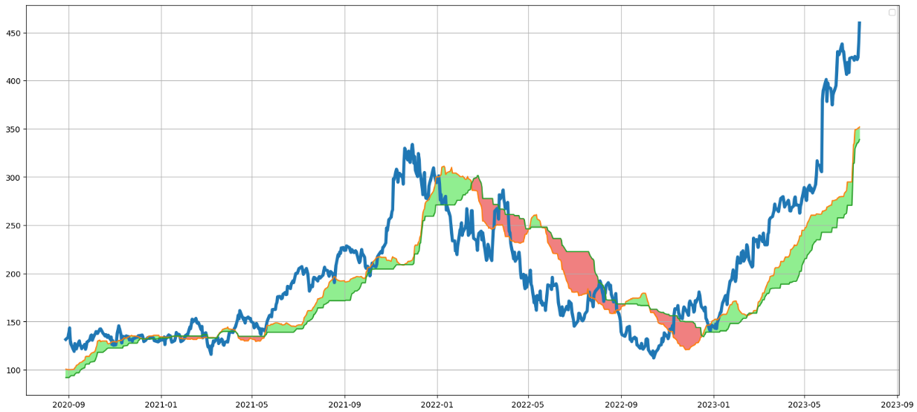
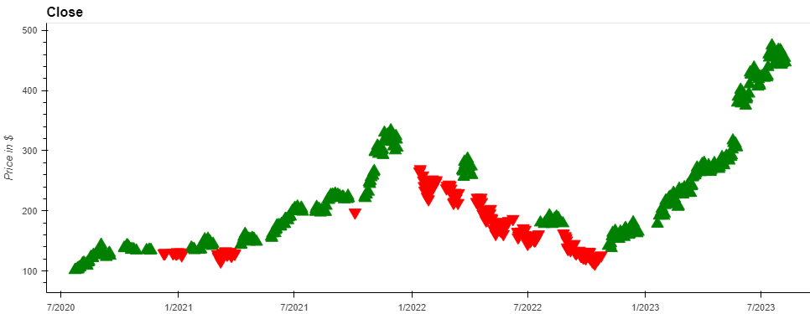
Ichimoku Cloud and what it means
Notes:
J

Slide 19
Post-mortem
One issue that we ran into was creating a classification report for the RSI and Ichimoku cloud. We would have liked to see a direct comparison between the accuracies to have a better understanding on why the combination of RSI and Ichimoku cloud is better than the SVM and Logistic Regression we have done in the past.
Another issue that arose was that we wanted to include the buy and sell signals (green and red triangles) on the Ichimoku Cloud plot but we could not make it work. In order to work around this, both were placed side by side.
Notes:
E

